Slide 1

One-Tier Architecture
By,
Samyuktha
Manjusha
Thayappan

Slide 2


What is One-Tier Architecture?
One-Tier Architecture
Flow Chart
Types Of Layer
OUR
AGENDA
Advantages of One-Tier
Disadvantages of One-Tier

Slide 3


What is One-Tier Architecture?
01
One-Tier Architecture is a monolithic systems
It keeps all of the elements of an application, including the user interface, middleware and back-end data, in one place.
02
03
Presentation, application logic, and resource management
are merged into a single tier.
One-tier architecture involves putting all of the required
components for a software application or technology on a
single server or platform.
04
05
However, the appeal of a single-tier architecture can relate to the costs
that are involved, where it might make more sense to keep simpler
applications contained in one easy platform.

Slide 4
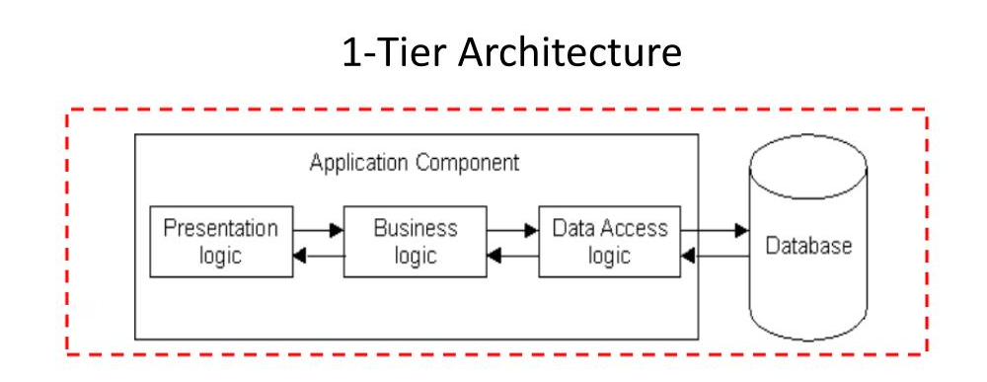
One-Tier Architecture

Slide 5
One-Tier Architecture Conti....
All 3 layers are on the same machine,
All code and processing kept on single machine.
Presentation, Business Logic & Data Layers are tightly connected,
Scalability: Single processor means hard to increase volume of processing.
Portability: Moving to a new machine may mean rewriting everything.
Maintainance: Changing one layer requires changing other layers.

Slide 6
Types Of Layers
Types Of Layers
Presentation
Layer
This layer passes the information which is given by the user in terms of keyboard actions, mouse clicks to the Application Layer
01
Application
Layer
It controls an application’s functionality by performing detailed processing.
02
Data Layer
03
The data is stored in this layer. Application layer communicates with Database layer to retrieve the data.

Slide 7
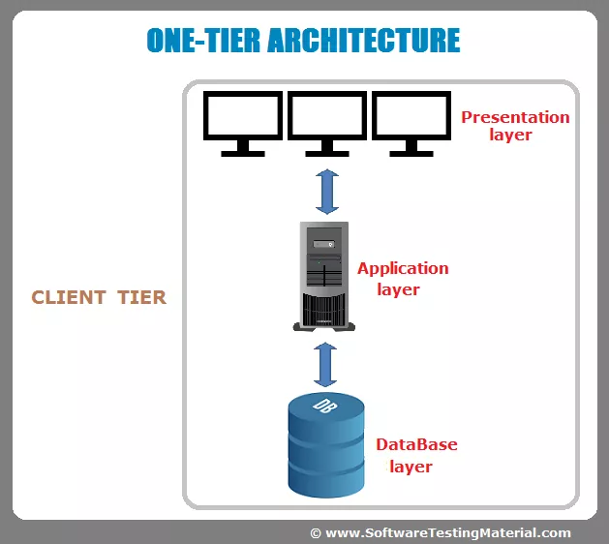
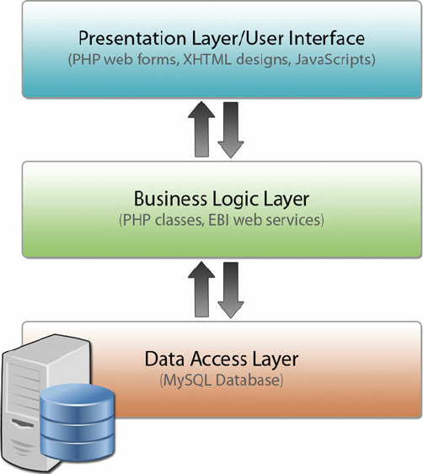
Client Architecture Conti....

Slide 8
Advantages Of One-Tier Architecture
Easy to implement and optimize performance.
Do not have compatibility or context switching issues.
The cost of deployment is less, Eg: development and management cost.
Fast for a single user because communication with another system is not necessary.

Slide 9
Disadvantages Of One-Tier Architecture
Completely unscalable.
Only one user can access the system at a given time via the local client.
Do not support remote/ distributed access for data resources.
Monolithic manner of the code causes higher maintenance.
The cost of the central mainframe is high.

Slide 10
Real Time Example
Software applications like MS Access, MS Excel, QuickBooks, and Peachtree all have the same in common: the application handles all three tiers (BL, UI, and DB).
The data is stored in a file on the local computer or a shared drive.
Eclipse is one of the example for 1-Tier Architecture.

Slide 11
Why One-Tier Architecture is difficult?
1-tier software packages are not very scalable and if the amount to data gets too big, then the software may be very slow or stop working.
And 1-tier architecture is simple and cheap, but usually unsecured and data can easily be lost if you are not careful.
Hence, people are now choosing 2-Tier and 3-Tier Architecture over 1-Tier Architecture.

Slide 12


Thank You
v

